Slide 1
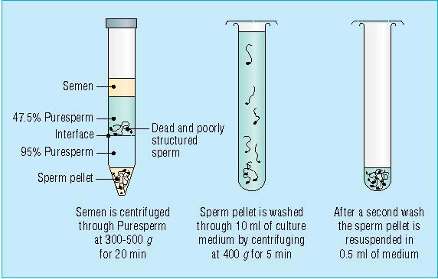

Slide 2
Gamete Intrafallopian Transfer
Laparoscopic technique in which oocyte and sperm placed in fallopian tube, allowing in vivo fertilization
Procedure
  Superovulation
  Ultrasound (US) guided transvaginal oocyte retrieval
0.1-0.2 ml sperm with 2-3 oocytes

Slide 3
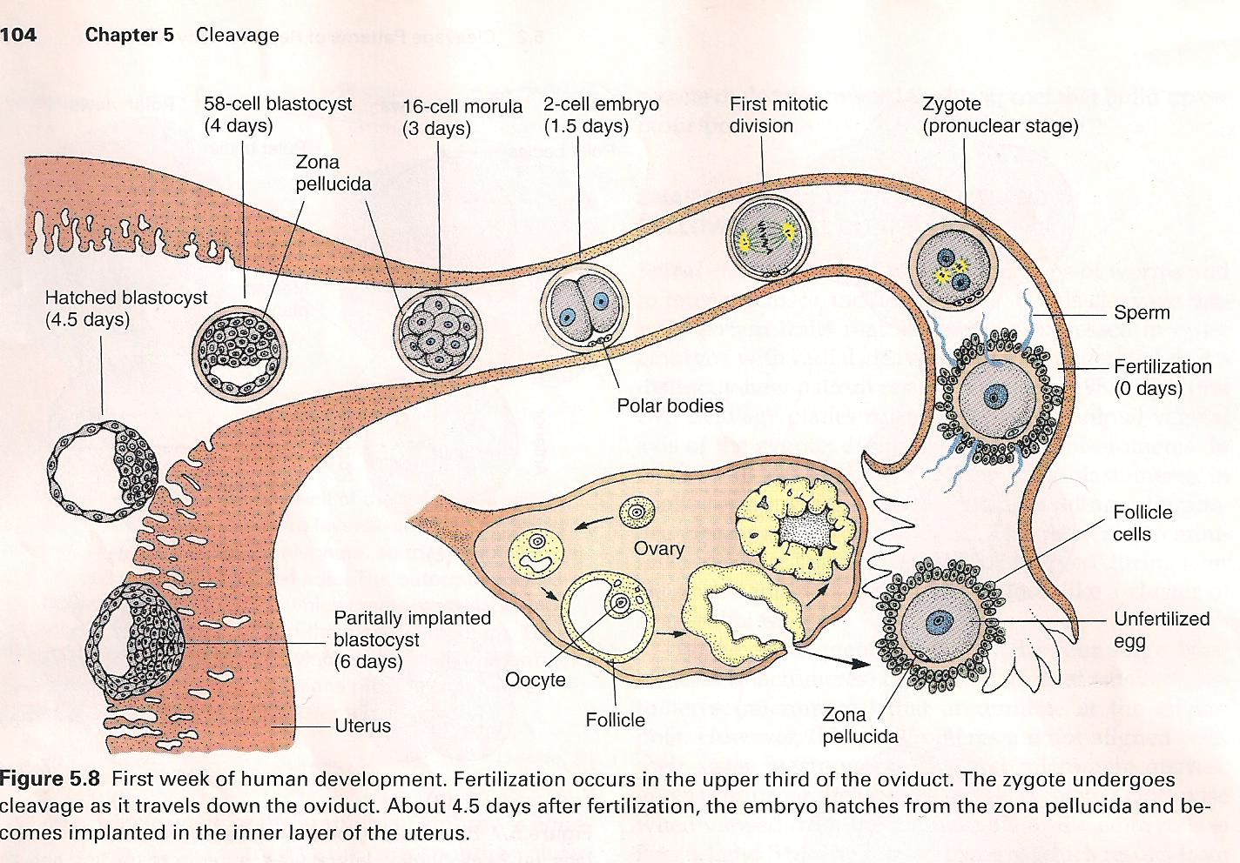
Intrauterine Insemination
Sperm sample deposited in uterus just before release of an oocyte (s) in a natural or stimulated cycle using a Soft catheter
Give hCG at injection or up to 24 hrs later
Sperm volume: 0.2-0.3 ml
Pregnancy rates
  Around 15% per cycle

Slide 4
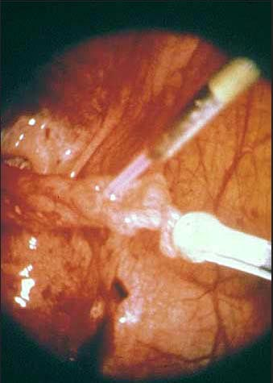

Slide 5
In vitro fertilization - IVF
Taking oocytes from woman
Fertilizing them in lab with her partner's sperm
Transferring resulting embryos back to her uterus 3 or 5 days later

Slide 6
IVF
Procedure
  Superovulation
  Insemination
  Embryo transfer
  Luteal support

Slide 7
IVF - Superovulation
Gonadotropin stimulation
Monitoring follicular development
Ultra Sound guided transvaginal oocyte retrieval
Oocyte fertilization with sperm

Slide 8
IVF - Insemination
Containers used
  Test tubes, Petri dishes, multi-well dishes
Each oocyte inseminated with 0.5-1.0 ml. processed motile normal sperm (PMNS)
Fertilization detected 12-20 hrs later by presence of
  2 pronuclei in oocyte cytoplasm or
  2 polar bodies in perivitelline space

Slide 9
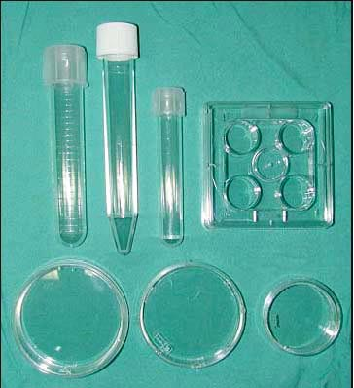

Slide 10
IVF - Insemination
Combination of maternal and paternal pronuclei 24 hrs after insemination
Further cleavages occur at 12 hrs intervals

Slide 11
IVF - Embryo transfer
Embryos transferred to uterus on 2nd or 3rd day after in vitro insemination
4-8 cells embryos
2-3 embryos transferred in 20 µl of culture fluid
Transabdominal Ultrasound to see fluid placed in uterus
Cryopreserve excess embryos

Slide 12
IVF - Luteal support
Progesterone (P4) necessary for pregnancy maintenance
Premature luteolysis in some superovulatory regimens
P4 supplementation until menstrual period occur or woman has positive pregnancy test

Slide 13
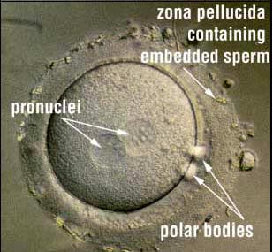

Slide 14
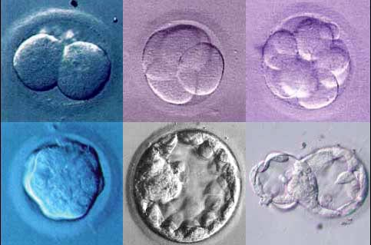

Slide 15
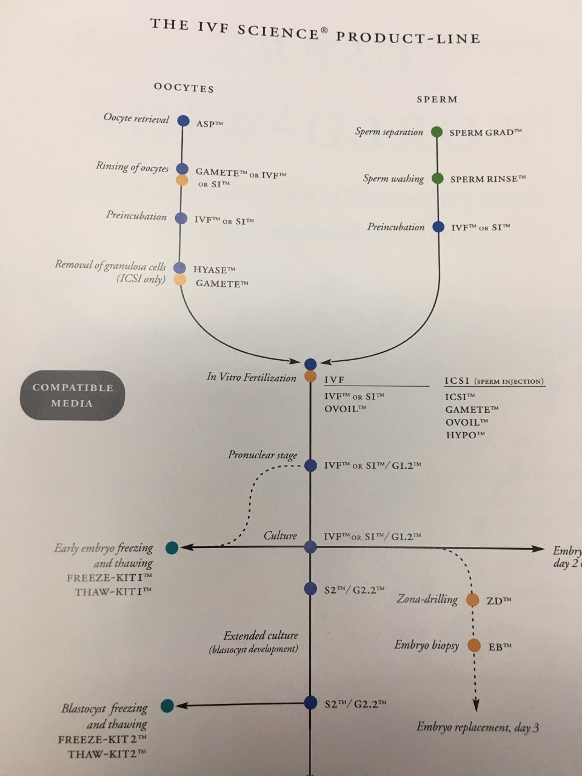

Slide 16
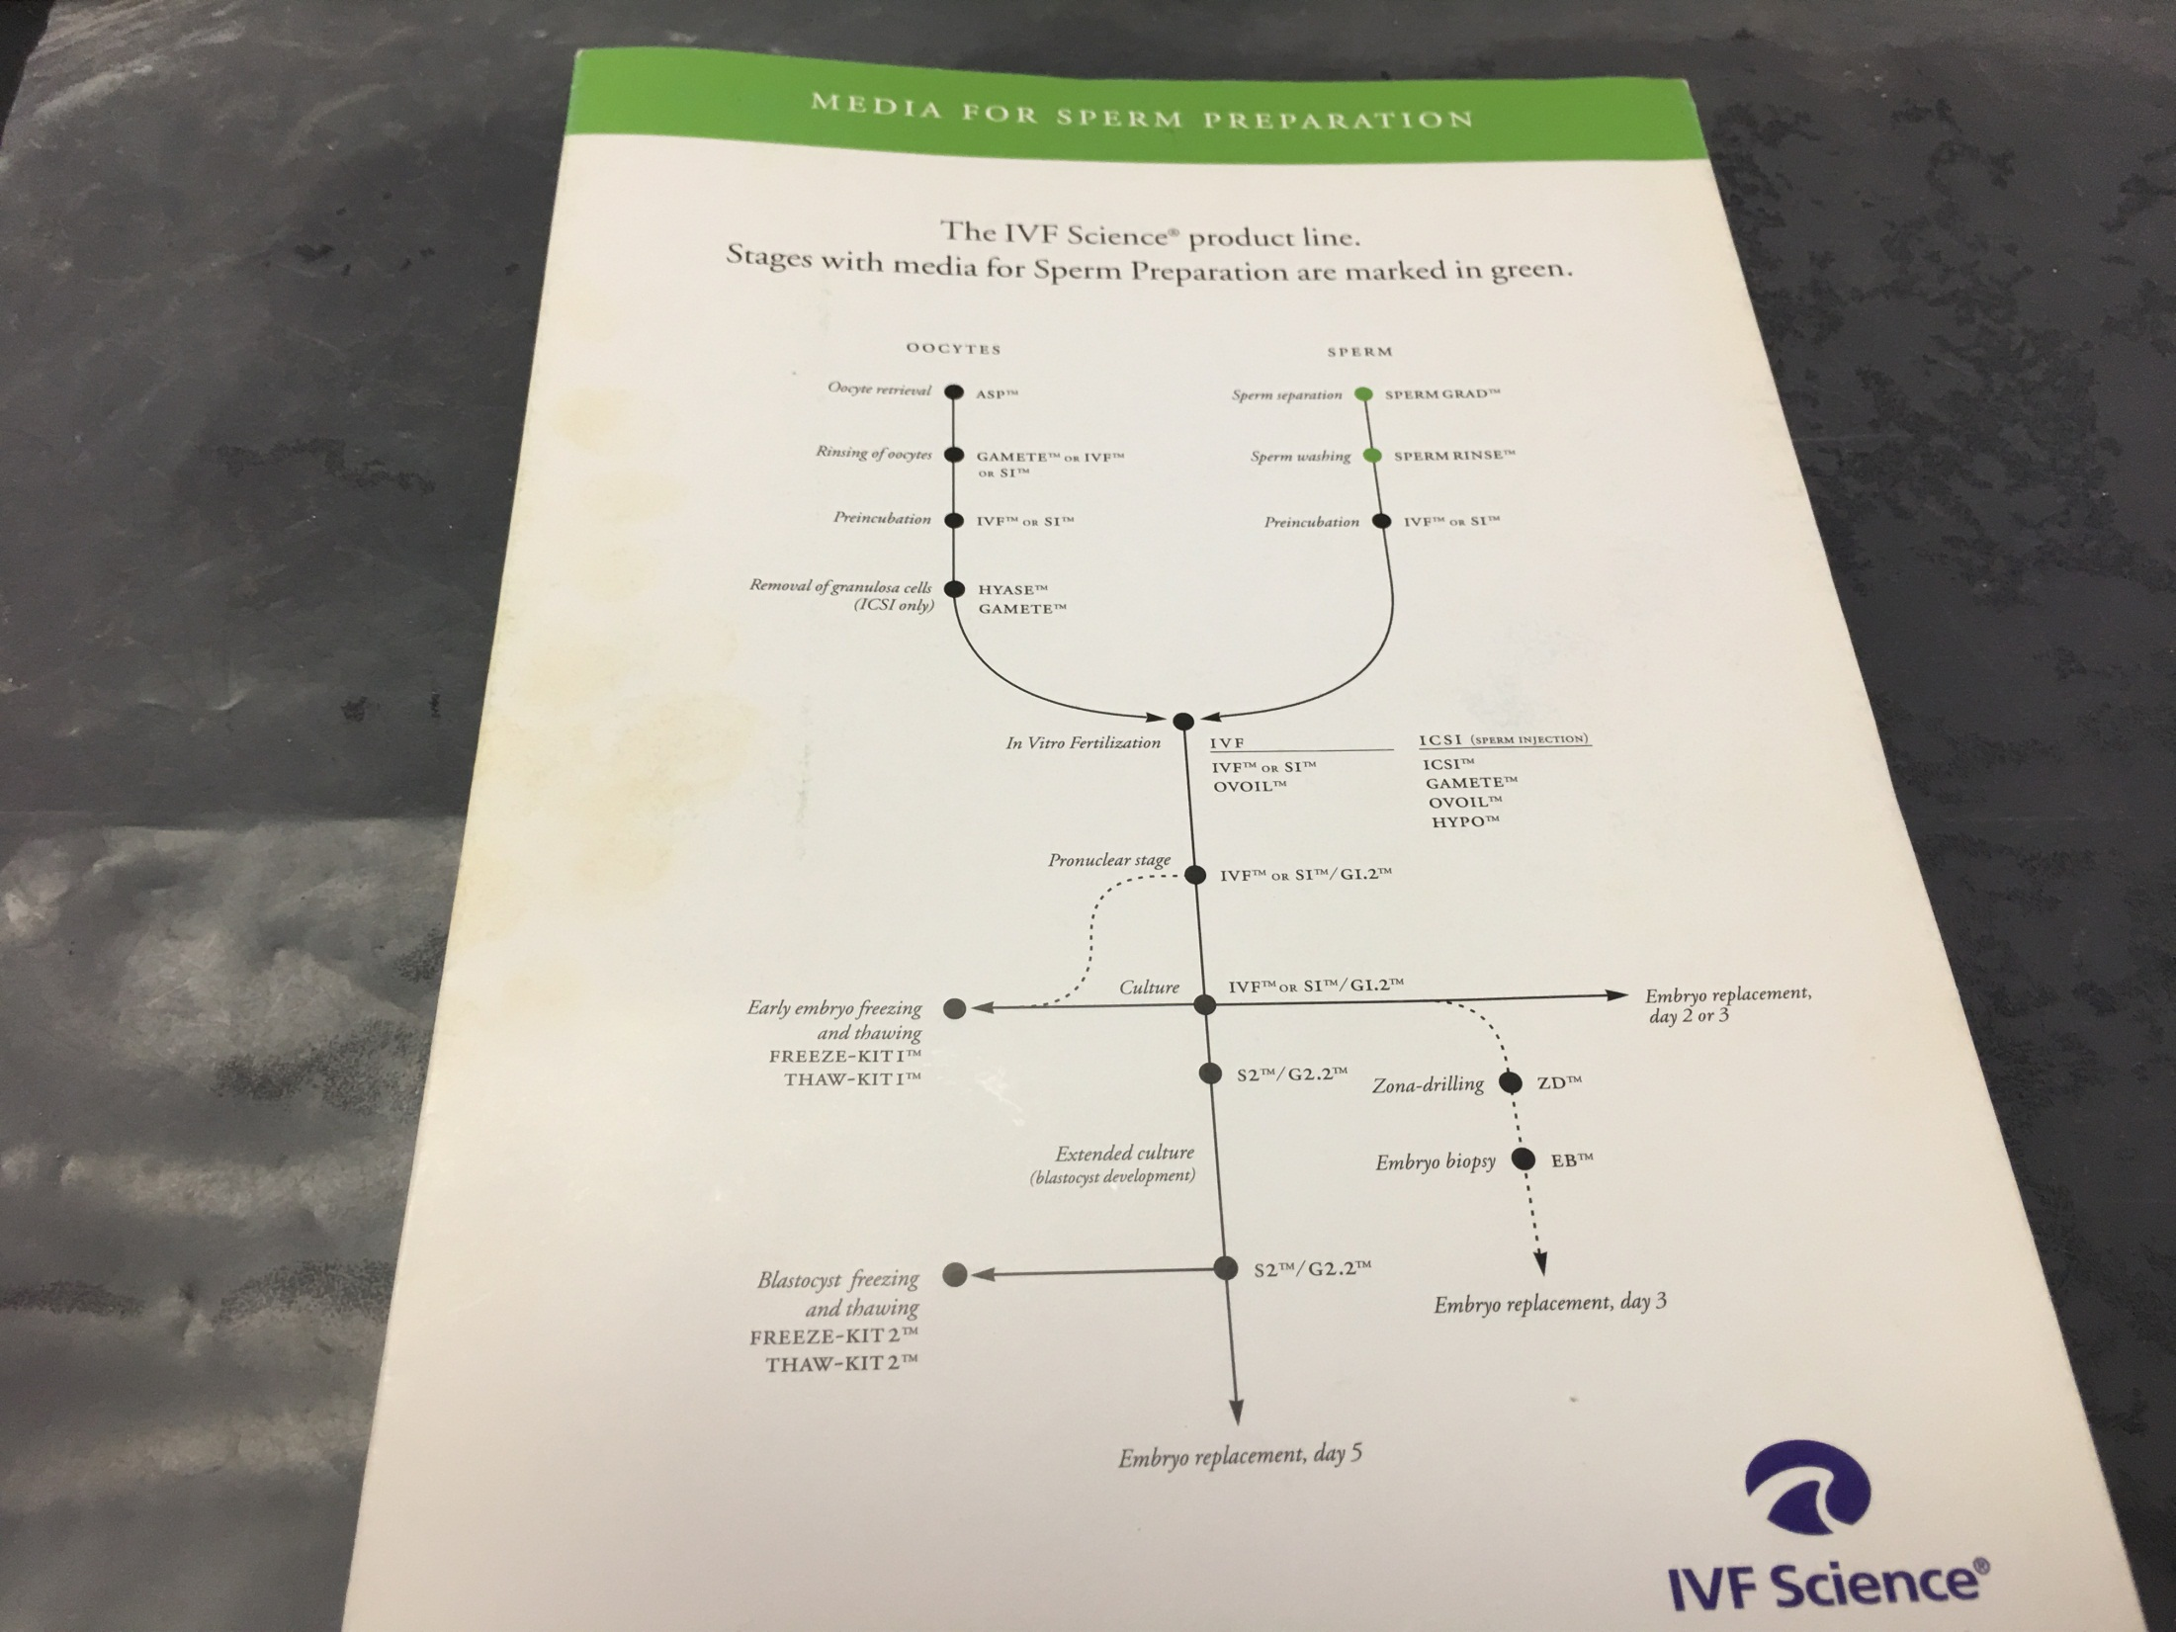

Slide 17
Intracytoplasmic Sperm Injection - ICSI
Injection of single sperm into single oocyte in order to get fertilization
Procedure
  Superovulation
  US guided transvaginal oocyte retrieval
  IVF
    Oocytes injected with sperm using special microscopes, needles and micromanipulation equipment

Slide 18
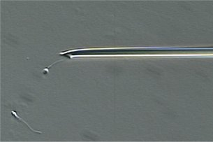

Slide 19
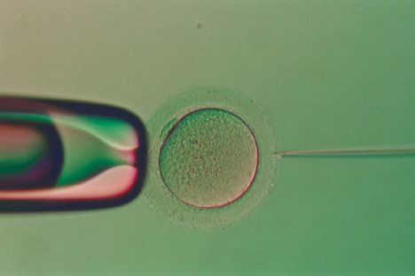

Slide 20
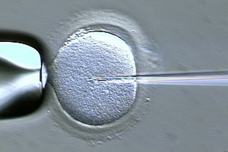

Slide 21
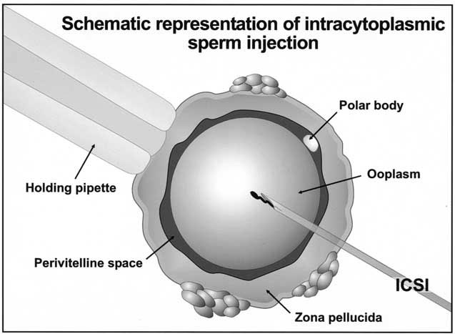

Slide 22
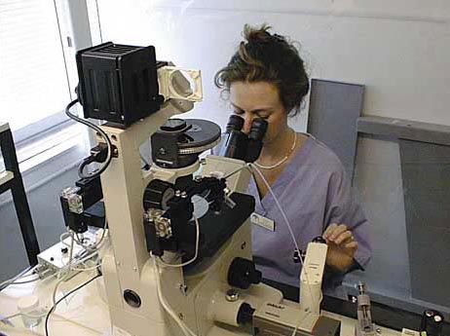

Slide 23
ICSI - Indications
Low sperm concentration, motility, abnormal morphology
Antisperm antibodies
Fertilization failure after conventional IVF
Ejaculatory disorders
Absence of vas deferens or obstruction of ejaculatory ducts

Slide 24

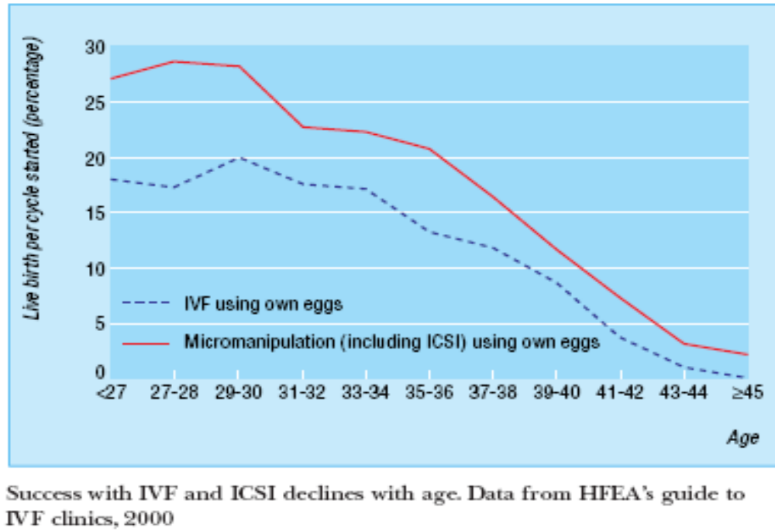

Slide 25
Assisted Hatching
Indications
  Couples having IVF with
    Female partner's age over 37
    Poor quality embryos
      Excessive fragmentation
      Slow rates of cell division

Slide 26
Assisted Hatching – Procedure
Embryo held with a specialized holding pipette
A needle used to expel an acidic solution against ZP
A small hole made in ZP
Embryo washed and put back in culture in incubator
Embryo transfer shortly after hatching procedure
  Hope for the best

Slide 27
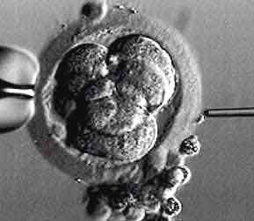

Slide 28
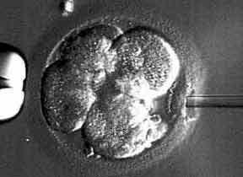

Slide 29
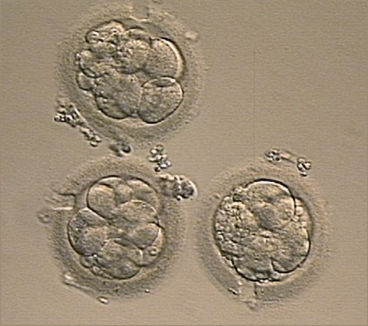

Slide 30
Further Advances And Uses Of Assisted Conception Technology
Cryopreservation of
  Sperm
  Embryo
  Oocyte
  Ovarian tissue
Growth of human follicles and oocytes in vitro
In vitro maturation and transplantation of human spermatozoa

